Slide 1
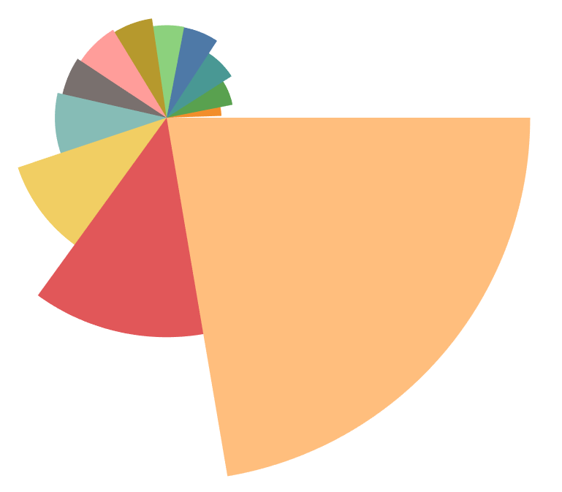
Coxcomb Graph/Astor Plot in PBI
A twist on the standard Pie/Donut Chart
A second measure can be used to drive the sweep angel
Open with Legacy Connection >> Data >> Convert to Custom SQL
[SQL] 0 as ToPad Union All [SQL] 100 as ToPad
[ToPad] Create Bin >> [Padded] with step 1
[Index] Index() calculated with [Padded]
[MaxSales] WINDOW_MAX(MAX([Sales])) calculated with [Padded]
[MaxQuantity] WINDOW_MAX(MAX([Quantity])) calculated with [Padded]
6. [Radius] [MaxQuantity]/WINDOW_SUM([MaxQuantity]/101) calculated with All
[SliceSize] [MaxSales]/WINDOW_SUM([MaxSales]/101) calculated with All
7. [Edges] calculated without [Padded]
if FIRST()=0 then 0 else lookup(RUNNING_SUM([SliceSize]),-1) END
8. X calculated with All
IF [Index]=1 THEN 0
else [Radius]*COS(WINDOW_MAX(2*PI())*[Edges] + ([Index]-2)*WINDOW_MAX(2*PI())*[SliceSize]/99)
END
Y calculated with All
IF [Index]=1 THEN 0
else [Radius]*SIN(WINDOW_MAX(2*PI())*[Edges] + ([Index]-2)*WINDOW_MAX(2*PI())*[SliceSize]/99)
END
width
depth
100
R
Y
θ
θ
1
O
X
Notes:
Today, we're going to looking at the coxcomb Graph. The coxcomb graph looks like a twist pie chart. But it have more than one measure visualized on this type of chart. The first measure controls the depth and the second measure controls the width.

